Slide 1
Vehicle Blind Spot Assist
Hani Hadidi
Tanzim Mokammel
Valikhan Kuparov

Slide 2
Outline
Reducing Vehicle Accidents
Our Objective
The Big Picture
Finer Details
Challenges Ahead

Slide 3
Reducing Vehicle Accidents
Background and Motivation

Slide 4
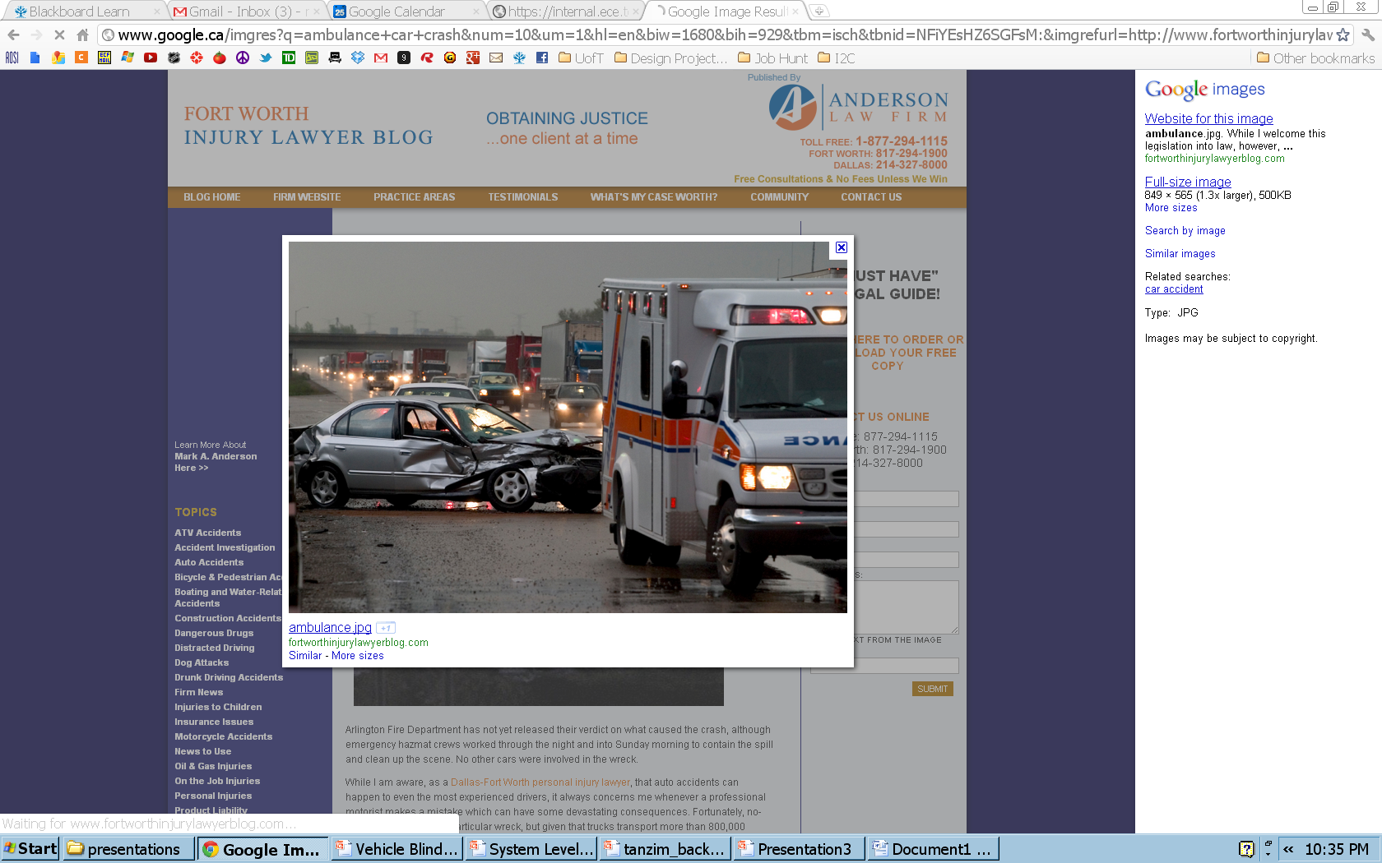
Vehicle Accidents
Vehicle accidents are accountable for:
Physical injuries
Mental Trauma
Financial Loss
Death
Notes:
http://www.google.ca/imgres?q=ambulance+car+crash&num=10&um=1&hl=en&biw=1680&bih=929&tbm=isch&tbnid=NFiYEsHZ6SGFsM:&imgrefurl=http://www.fortworthinjurylawyerblog.com/truck_bus_wrecks/&docid=6gVGBuWXSdgBTM&imgurl=http://www.fortworthinjurylawyerblog.com/ambulance.jpg&w=849&h=565&ei=bbYgT_j0A4Hn0QH01I3rCA&zoom=1&iact=hc&vpx=904&vpy=54&dur=1625&hovh=183&hovw=275&tx=151&ty=82&sig=106739473343961642775&sqi=2&page=1&tbnh=132&tbnw=173&start=0&ndsp=40&ved=1t:429,r:4,s:0

Slide 5
Accident Rates are Declining
Over the years, we have been seeing a decline in the number of vehicle accidents.
Figure 5: Fatal Collisions and Fatality Victims (1990-2009)
Figure 6: Collisions Resulting in Injury and Victims Injured (1990-2009)
Notes:
[1] Transport Canada, “Canadian Motor Vehicle Traffic Collision Statistics: 2009”, Internet: http://www.tc.gc.ca/eng/roadsafety/resources-researchstats-menu-847.htm, Jun. 01, 2011 [Sep.11, 2011].

Slide 6
Room for Improvement
The numbers are still high!

Slide 7
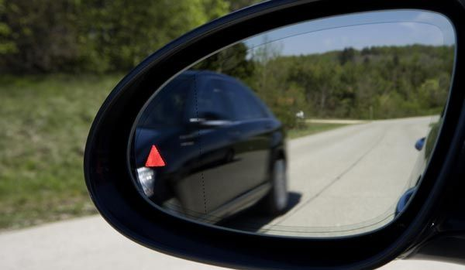
Why the Blind Spot?
95% of accidents are caused by bad driving behavior
One common driving behavior is to not check the vehicle’s blind spot while changing lanes

Slide 8
Similar Concerns
Over the years, many major manufacturing companies have been motivated by similar concerns:
-BMW
-Volvo
-Ford
-Mercedes

Slide 9
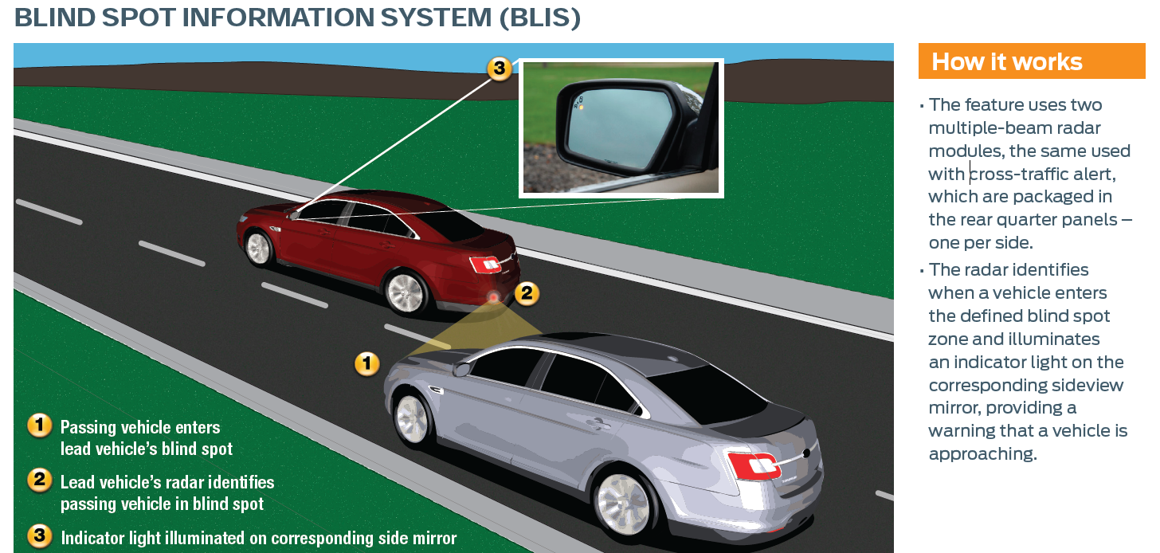
Example – Ford BLIS
Notes:
[5] Unknown. “Blind Spot Information System (BLIS) with Cross-Traffic Alert”. Internet: http://media.ford.com/images/10031/BLIS.pdf, Jun. 7, 2011 [Sep. 15, 2011].

Slide 10
Room for Improvement
Help reduce accidents through an universal, accessible and affordable device which aids users be aware of dangers in the Blind Spot, and make improvements to the currently available technology

Slide 11
Our Objective
Project Goals and Requirements

Slide 12

Project Goal
Design a device, which will:
Identify obstacle in blind spot
Anticipate approaching obstacle
Warn user about danger
Automated lock of steering into obstacle

Slide 13
Project Requirements
Functional Requirements
The unit shall have sensors mounted on the sides
The unit shall have a microcontroller to compute:
the relative speed of the obstacle (max 10% error)
time before approaching obstacle appears in blind spot (if not already there)
The unit shall have a feedback mechanism to warn the user
The unit shall have an override mechanism that will prevent users from making unsafe lane changes

Slide 14
Project Requirements (continued)
Objectives
Work correctly regardless of light and weather conditions
The blind spot detection component of the unit (no vehicle override) should be a standalone device
The microcontroller should be hidden from the user’s view

Slide 15
The Big Picture
System Level Overview

Slide 16
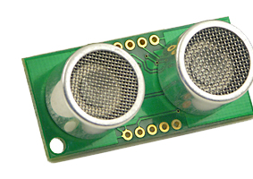
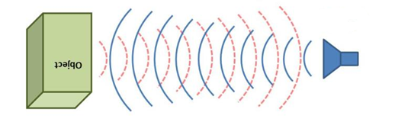

System Level overview
Obstacle Detection
Anticipation
Ultrasonic Sensor -SRF05
Obstacle
Distance

Slide 17
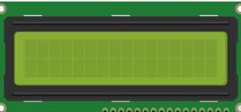
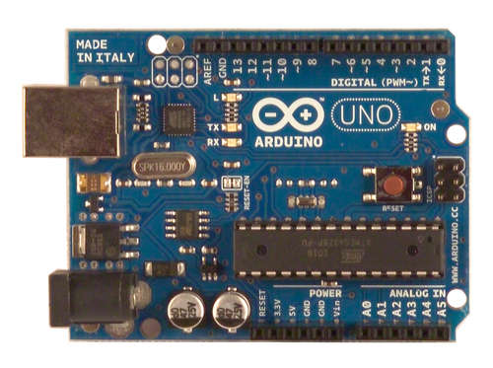
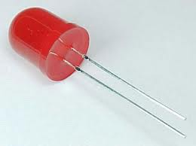
User Feedback
Output
Distance
Speed
Time
Arduino
LCD screen
Speed time calculation
Blinking- danger level
LED

Slide 18
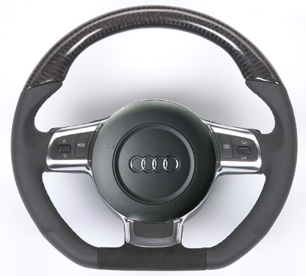
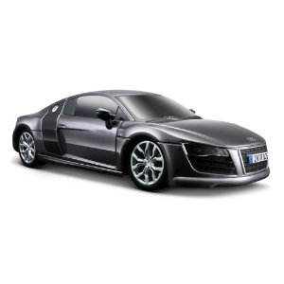
Automation
Vehicle Control
Arduino
User Vehicle
F
L
R
Speed time calculation
B

Slide 19
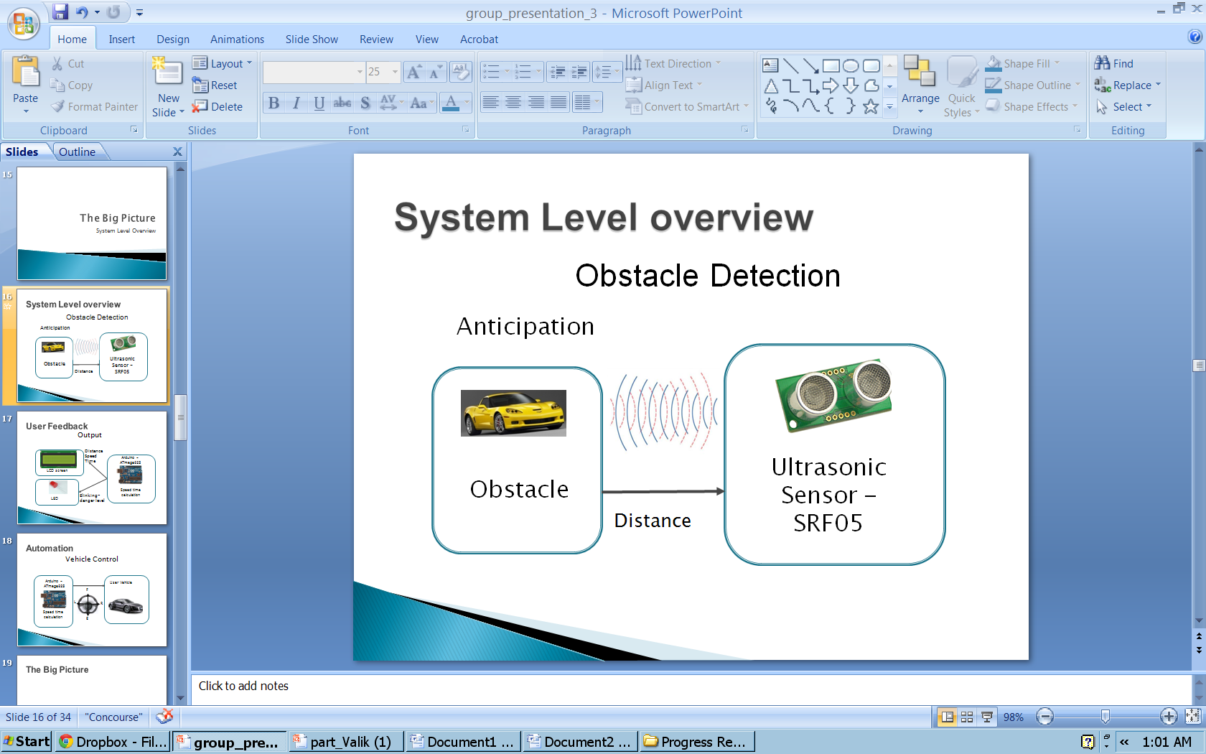
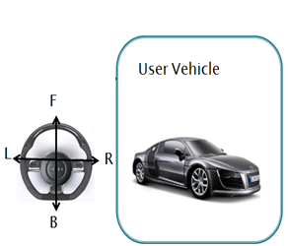
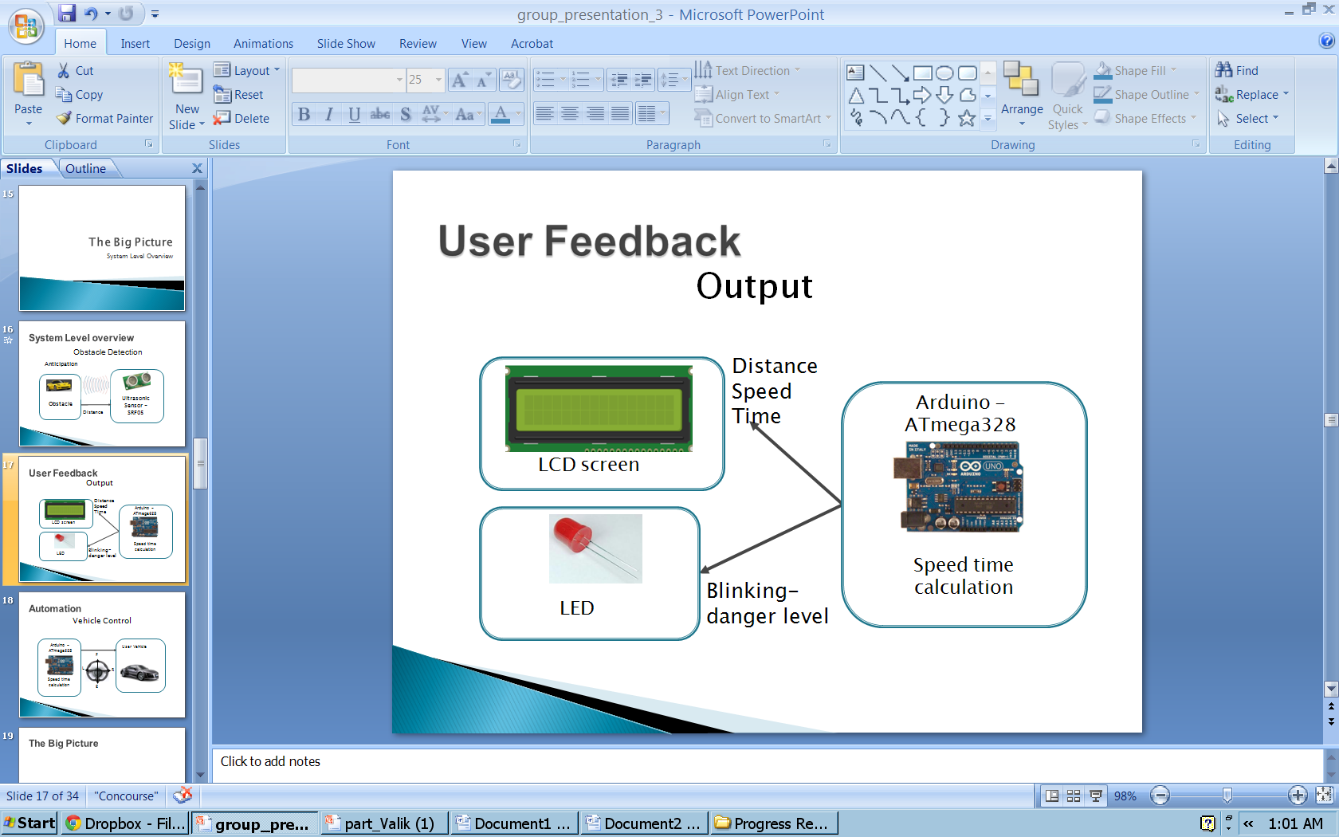
The Big Picture
Obstacle Detection/ Anticipation
Automation

Slide 20
Finer Details
and Progress to Date

Slide 21

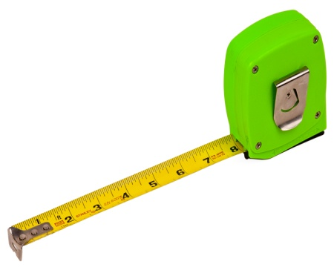
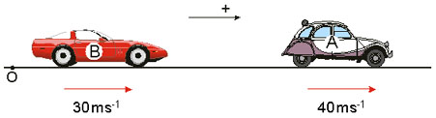

Detection/Anticipation Module
Time
Distance
Relative Speed

Slide 22
Detection/Anticipation Module – Completed Milestones
Distance Calculations
Distance between an object and the sensor can be measured to the nearest cm

Slide 23
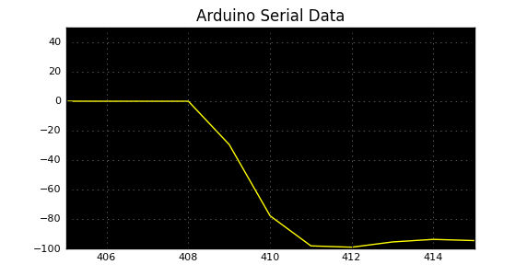
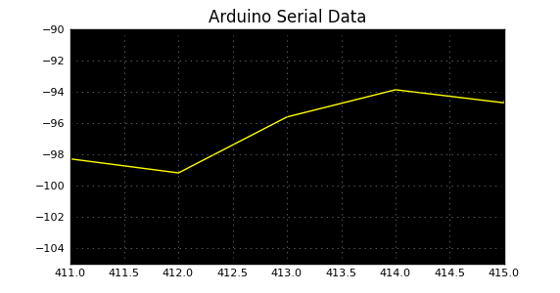
Detection/Anticipation Module – Completed Milestones
Speed Calculations
Speed can be calculated within +-10% accuracy between the stationary sensor, and a moving obstacle
Example:
Speed
Speed
Sample Point
Sample Point

Slide 24
Detection/Anticipation Module – Issues Faced
Sensor’s range is highly reduced due to the size of the obstacle (1.5 m to 3 m)
We anticipate further error margin once the sensor is mounted on the vehicle
Real-Time Plots for Verification
Wireless retrieval of microcontroller data for verification

Slide 25
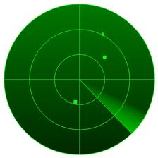
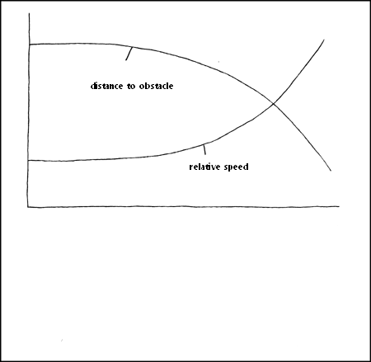
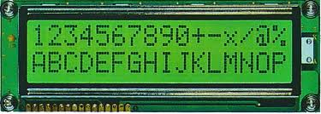
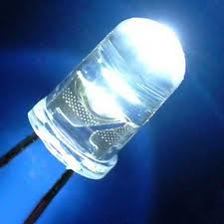
Output Module - Possible Solutions and Design Alternatives
Possible solution | Type
Visual | Graphical
 | Numerical
 | Simple - blinking light

Slide 26

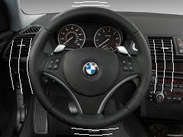
Output Module - Possible Solutions and Design Alternatives
Possible solution | Type
Auditory | Beeping sounds
Physical | Vibration of the steering wheel

Slide 27
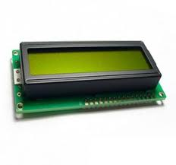
Output Module - Proposed Solution: Output module
+
simple, yet informative feedback
quantitative feedback
the least costly among the alternatives

Slide 28
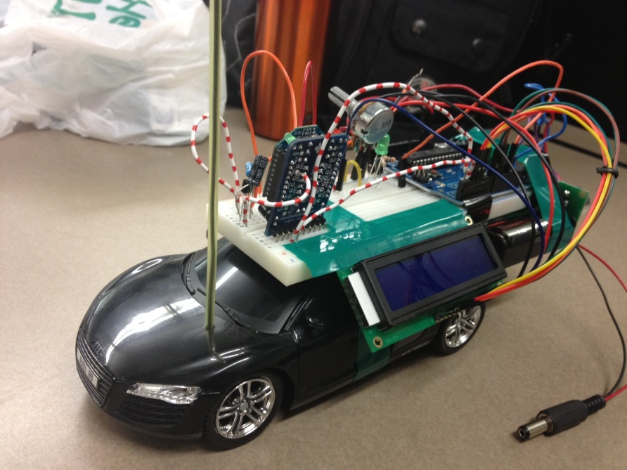
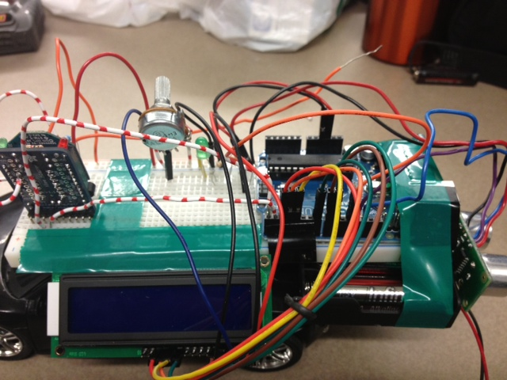
Output Module - Implementation
LCD Display
LED light
Number of Characters: 16 characters x 2 Lines
Character Table: English-European
Module dimension: 80.0 x 36.0 x 13.2mm3
View area: 66.0 x 16.0 mm
Character size: 2.96 x 5.46 mm
Operating Temperature: -20°C to + 70°C
Blinking frequency: 1-4 Hz to solid state
Size: 5 mm diameter
Wavelength: 565nm
Operating Temperature: -38°C to + 78°C

Slide 29
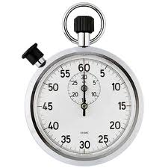
Output Module - Next Steps
Relative speed
Distance to obstacle
Remaining time to change lane
Need: to implement algorithm

Slide 30


Automation - Input
Char
i
l
j
k
,
.
ASCI DEC
105
108
106
107
44
46
User Input
Computer output

Slide 31
Automation - Output
Action
Forward
Right
Left
Backward
Increase speed
Decrease speed
ASCI DEC
105
108
106
107
44
46
F
L
R
Hani insert pic of the arduino circuit
B

Slide 32

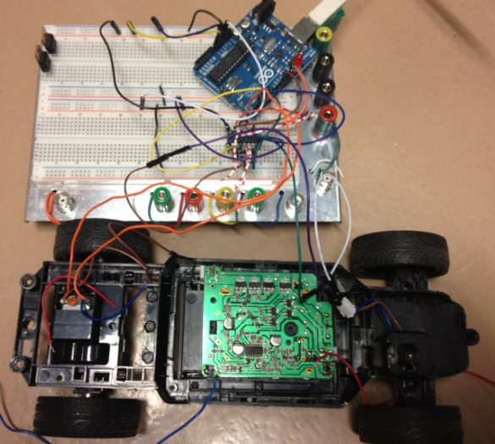
Automation
I received:
ASCI DEC
105
108
106
107
Speed Value: 200
Serial output from car

Slide 33
Challenges Ahead

Slide 34
Summary of Next Steps
Obstacle Detection + Output
Time calculations
Improve accuracy
Automation
Improved Control
Integration
Combining detection and automation modules
Testing

